Slide 1
Introduction to Machine Learning
Goldsmiths University

Slide 2
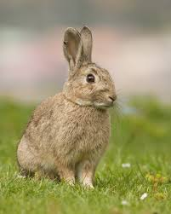
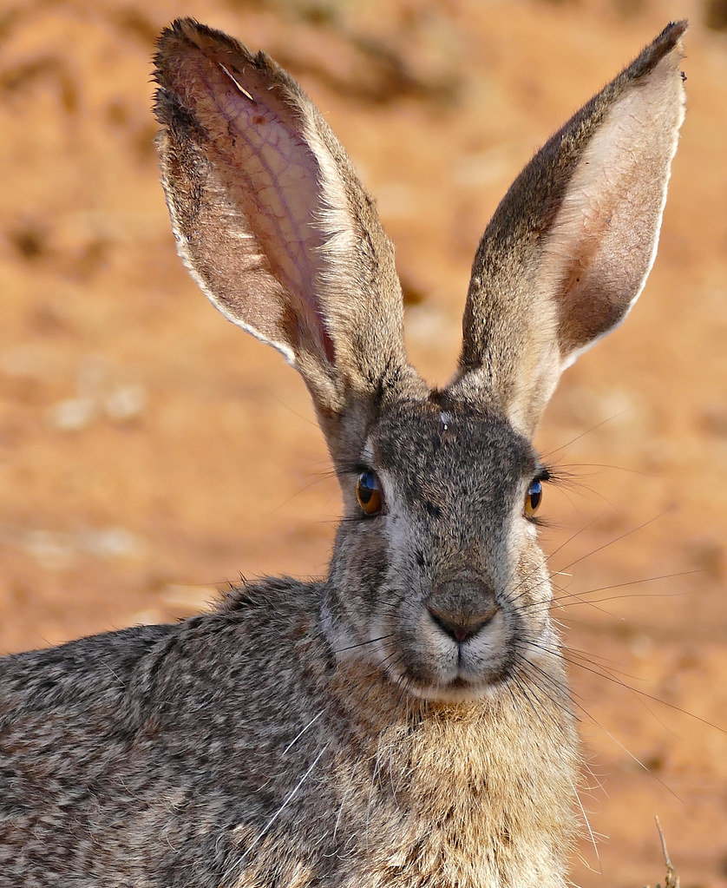
Decision Trees
Notes:
DTs can be represented as a tree-like hierarchy of nodes that allow us to arrange information – our dataset – in a structured way.
Take this example where we want to distinguish between two types of animal – rabbits and hares. We have at least two features: whether the animal can be found in burrows or not, and its ear length.

Slide 3


Decision Trees
burrows?
root node
no
yes
leaf
hare
ear length
Interior node
$>9.4$ cm
$≤9.4$ cm
leaf
hare
leaf
rabbit
Notes:
At the top of the tree we have the root node, which asks a binary question of the most distinguishing feature between the two classes. This is the feature that contains the most information. In this case, we know that hares almost never burrow under the ground, whereas all rabbits do.
If the animal does not burrow, it is most certainly a hare.
If the animal can be found in a burrow, we move onto the we can further separate using the second most informative feature: ear length. This time we use a condition on this feature, with values above a certain threshold designating one class, and equal to or below that threshold to the other class.
The bottom-most nodes, where we make our final class designations (rabbit or hare) are known as leaf nodes.
Given new data to be classified, we simply descend through the tree until we get to an appropriate leaf node.

Slide 4



Decision Trees
burrows?
no
yes
hare
ear length
$$burrows$$
hare
rabbit
$>9.4$ cm
$≤9.4$ cm
yes
hare
rabbit
decision boundary
no
hare
$$ear (cm)$$
$$9.4$$
Notes:
Decision trees are known as white box models. This means that decision trees are easy to interpret. This is because they are based on a hierarchy of simple classification rules which are easily visualised.
This is in opposition to black-box models, like deep neural networks, where the decision making process is far more opaque.
With Decision trees we can easily traverse the tree by eye and see the criteria for how decisions are made.
If we were to plot some sample data on the feature space of this rabbit vs. hare example, we might see something like this.
Mapping the decision tree onto this space creates what are known as decision boundaries. For example, the root decision divides the data into two areas, burrows and does not burrow. Any new sample that falls into the ‘no’ side will be classified as a hare.

Slide 5
Decision Trees
burrows?
no
yes
hare
ear length
$$burrows$$
hare
rabbit
$>9.4$ cm
$≤9.4$ cm
rabbit
yes
hare
rabbit
no
hare
$$ear (cm)$$
$$9.4$$
Notes:
The 2nd level decision, on ear length, only then applies to data that has a yes to burrowing.
Continuing in this vain, adding decision criteria and making the tree much deeper, can lead to very complex and nonlinear decision boundaries that can capture almost any shape.

Slide 6
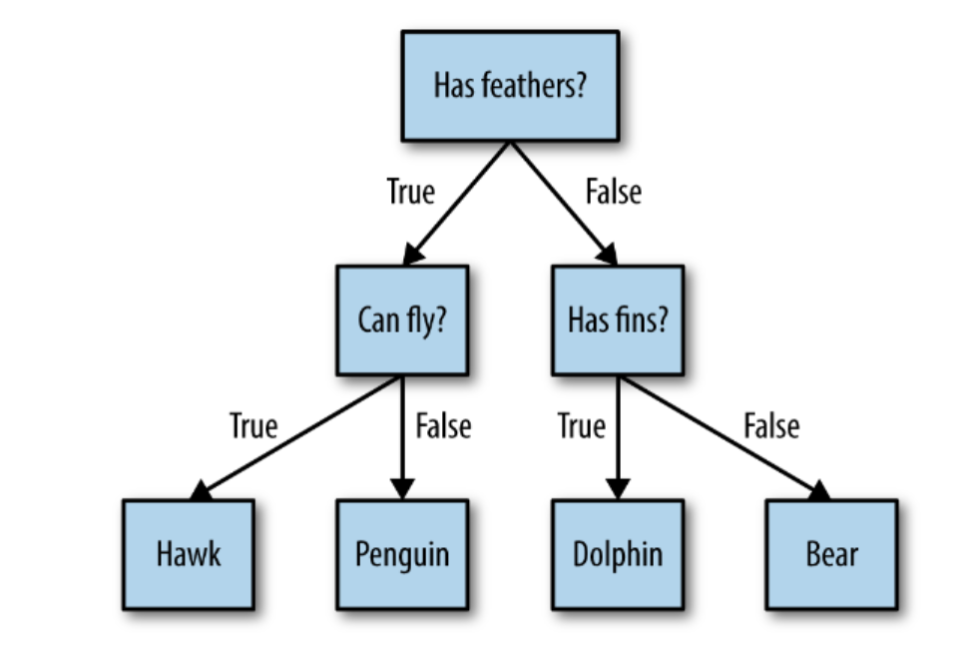
Decision Tree
Decision Tree algorithm learns a hierarchy of if/else questions

Slide 7
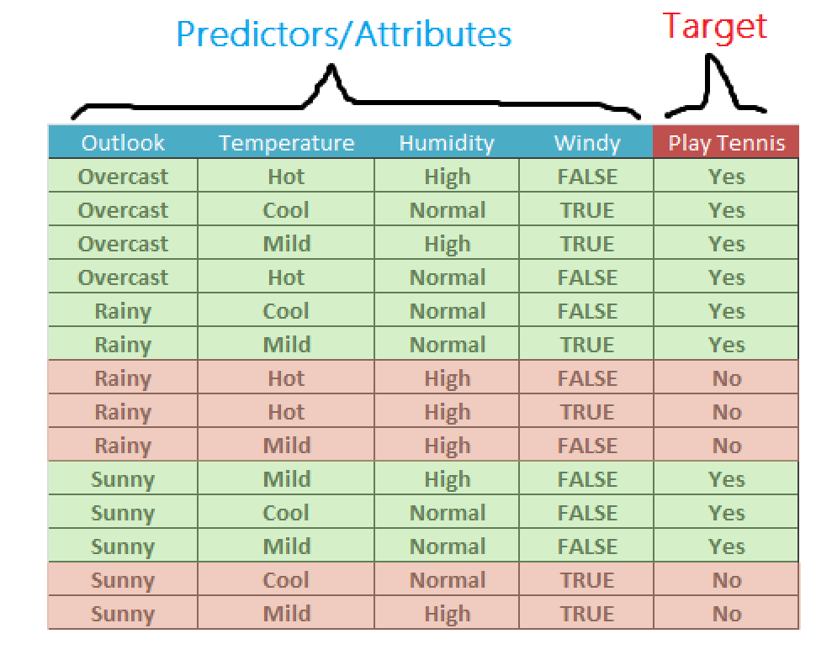
New data: rainy, high humidity, windy ?
NO
outlook
Sunny
3 Yes
2 No
Overcast
4 yes
Rainy
2 yes
3 no
Split further
Pure Subset
Split further
windy
0 yes
2 no
No wind
3 yes
0 no
High Humidity
0 yes
3 no
normal Humidity
2 yes
0 no
Pure Subset
Pure Subset
Pure Subset
Pure Subset

Slide 8
How does it work
CART (Classification and Regression Trees) → uses Gini Index(Classification) as metric.
ID3 (Iterative Dichotomiser 3) → uses Entropy function as metrics
The idea is to iterate along the samples and the features values and chooses the split that creates the most homogeneous two groups after the split, using GINI or ENTROPY to evaluate the splits.

Slide 9
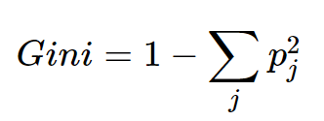
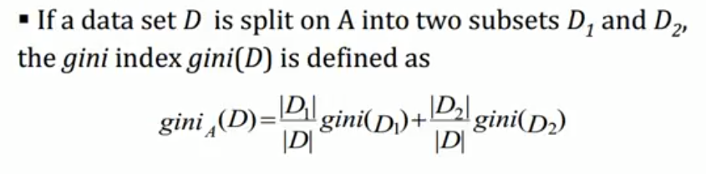
We use the Gini Index as our cost function to evaluate splits in the dataset.
A Gini score gives an idea of how good a split is by how mixed the classes are in the two groups created by the split. All elements being in the same class gives a Gini score of 0, whereas a 50/50 split would have a score of 0.5 (the maximum).

Slide 10
How to do the splits? Original GINI = 1 - 9/14^2 - 5/14^2 = 0.48 gini
GINI(yes|outlook=Sunny) = 1-(2/5)^2 - (3/5)^2 = 0.48
GINI(yes|outlook=Overcast) = 1-(0/4)^2 - (4/4)^2 = 0
GINI(yes|outlook=Rainy) = 1-(3/5)^2 - (2/5)^2 = 0.48
GINI after split on Outlook:
5/14 *0.48 + 4/14 * 0 + 5/14 * 0.48 = 0.3429
GINI(yes|Temp=Hot) = 1-(2/4)^2 - (2/4)^2 = 0.5
GINI(yes|Temp=Mild) = 1-(2/6)^2 - (4/6)^2 = 0.44
GINI(yes|Temp=Cool) = 1-(1/4)^2 - (3/4)^2 = 0.375
Gini after split on Temp:
4/14 *0.50 + 6/14 * 0.44 + 4/14 * 0.375 = 0.44
Why did we choose “Outlook” for making the first split?
Information gain (IG) = 0.48 (original GINI) - 0.34 (Gini Outlook)
Outlook gives us gini closer to 0, resulting in a higher IG

Slide 11
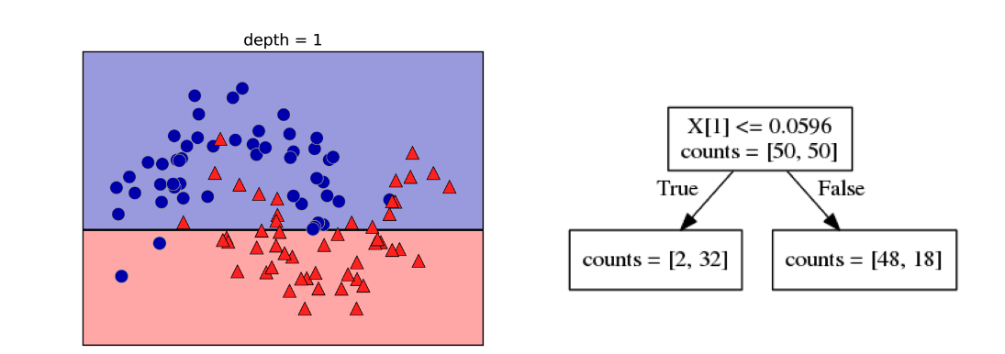
ML data is usually expressed as continuous features. So the decision becomes: 'is feature 'f' larger than value 'v'?
The algorithm iterates and choose the split with the lower GINI (or higher IG).

Slide 12
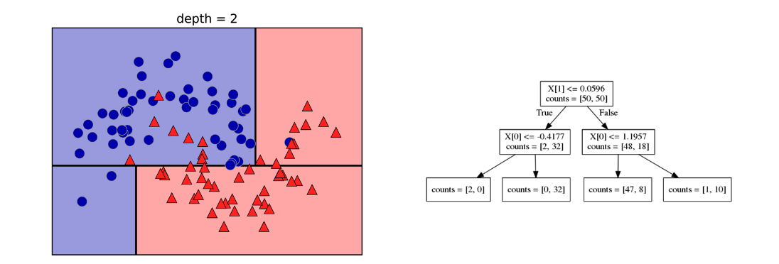
Now we look at feature x[0] (x axis)
each test (split in the tree) concerns only a single feature

Slide 13
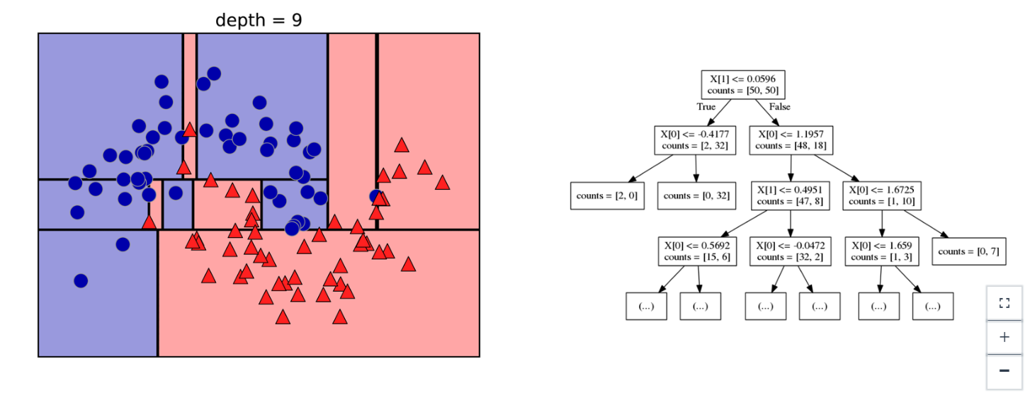
For a 'pure' tree, the model continues to split until it each region contains only one class type

Slide 14
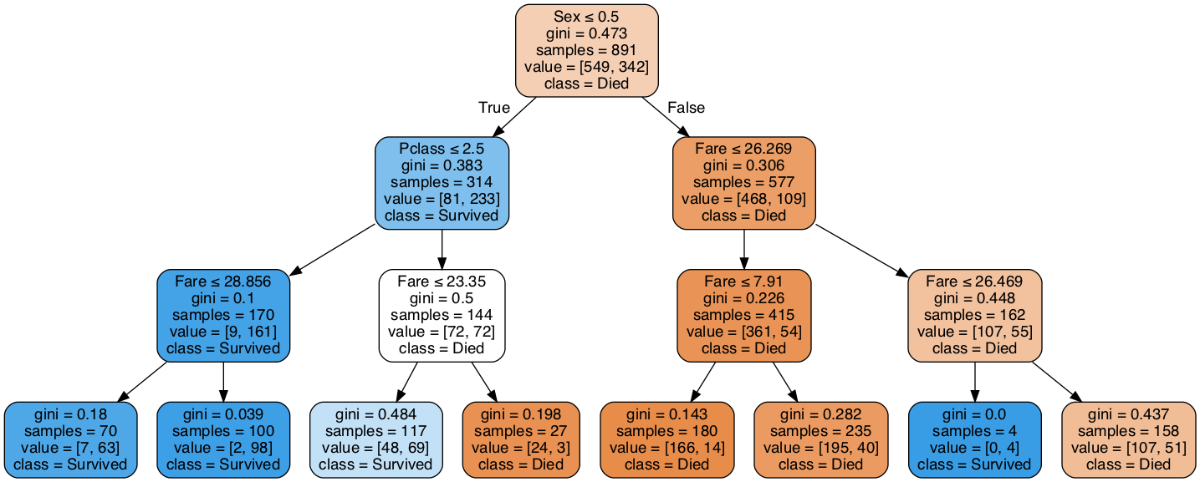
Titanic dataset example.
Notice that the class is predicted based on majority of votes
In regression we choose the average value in the subset for prediction
https://scikit-learn.org/stable/modules/generated/sklearn.tree.DecisionTreeClassifier.html#sklearn.tree.DecisionTreeClassifier
https://scikit-learn.org/stable/modules/generated/sklearn.tree.DecisionTreeRegressor.html#sklearn.tree.DecisionTreeRegressor

Slide 15
Pros and Cons
Decision Trees can perform both classification and regression task.
They are orthogonal sensitive. No diagonal boundary lines only chess board like.
in general they are very sensitive in small variation in the data during training
Simple to understand and to interpret. Trees can be visualised.
Requires little data preparation. Other techniques often require data normalisation, dummy variables need to be created and blank values to be removed. Note however that Scikit Learn does not support missing values.
Decision-tree learners can create over-complex trees that do not generalise the data well. This is called overfitting.
Decision trees can be unstable because small variations in the data might result in a completely different tree being generated. This problem is mitigated by using decision trees within an ensemble.
Decision tree learners create biased trees if some classes dominate. It is therefore recommended to balance the dataset prior to fitting with the decision tree.

Slide 16

Ensemble methods: the wisdom of the crowd
Naïve Bayes
KNN
Decision Tree
…
…
Notes:
Ensemble methods work along this basic premise. We take a dataset and use it to train an ensemble of predictors.
Lets take a look at a particular ensemble used for classification: the voting classifier.
In the example shown, we will train an ensemble of several different base classifiers – Naïve Bayes, KNN, Decision Tree, plus some others.

Slide 17
Ensemble methods: majority vote classification
Naïve Bayes
Majority Vote
KNN
New
Sample
Decision Tree
…
…
Notes:
Classification works by feeding the trained model with a new data sample. Each classifier outputs their prediction, and the result is aggregated to get the overall ensemble output.
In this case, the aggregation is done using Majority vote. This simply counts the classifier outputs and chooses the most common.
Majority vote is regarded as a hard vote – the largest count wins.

Slide 18
Ensemble methods: regression
Naïve Bayes
Average
0.5
KNN
0.1
New
Sample
0.5
Decision Tree
0.6
…
…
0.9
Notes:
We could alternatively feed probability values from each base classifier and take the average of these. This would allow the ensemble to take into account any uncertainty in the classifications. Such an aggregation would be called a soft vote.
Soft voting can be preferable to hard voting because it can give more weight to highly confident predictions – and lead to improved ensemble performance.
This example is for classification, but the same principle is applied for regression. This time the outputs of each constituent regressor can be averaged to produce the aggregate result.
Each of the constituent prediction algorithms might be weak learners, but when combined into an ensemble, the performance is strengthened considerably.
Even if the individual learners don’t do much better than random guessing, the ensemble will still have a strong performance – provided there are a sufficient number of diverse weak learners.
Just like the villagers guessing the weight of Galton’s ox, a lot of independent guesses that are ever so slightly better than random will together help us find the best answer.

Slide 19
Random forest
(All Decision Trees)
Notes:
One of the most powerful ensemble methods is known as random forests.
This is an ensemble that uses bagging together with decision trees as its base predictor.
That is, subsets of data are resampled with replacement from the original, and each is used to train a decision tree.
As a reminder, let’s take another look at decision trees.

Slide 20
Random forest
X
X
Y
X
Y
Notes:
One of the most powerful ensemble methods is known as random forests.
This is an ensemble that uses bagging together with decision trees as its base predictor.
That is, subsets of data are resampled with replacement from the original, and each is used to train a decision tree.
As a reminder, let’s take another look at decision trees.

Slide 21
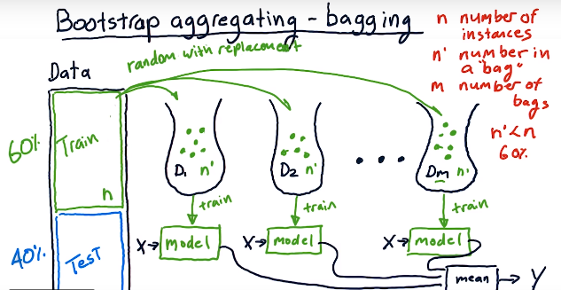
Random forest : bagging with replacement

Slide 22
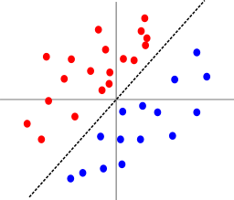
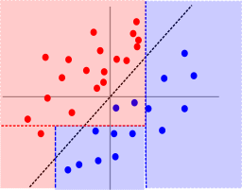
Random forest
Random Forests are one of the most common ensemble methods, which consists of a collection of Decision Trees.
We repeatedly select data from the data set (with replacement) and build a Decision Tree with each new sample.
It is important to note that since we are sampling with replacement, many data points will be repeated and many won’t be included as well.
It will run a full depth decision tree on each subset
But it also consider only a set of randomly selected features.
In the case of classification with Random Forests, we use each tree in our forest to get a prediction, then the label with the most votes becomes the predicted class for that data point.
DT are greedy search space (they think one step ahead not what would happen at the end of the tree if I split now). Therefore the tree found might not be the best one.
DT can risk overfitting but if we reduce the depth of the tree to make it more general it will become soon a bad predictor. RF solves some of these issues.

Slide 23
Extra

Slide 24
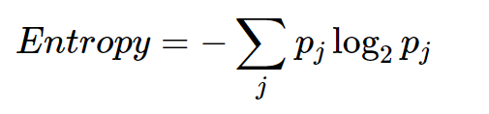
ID3 algorithm
You not only keep the yes and no but also the counts of how many of them.
We want to measure the “purity” of the split.
If we have a subset of 4 yes and 0 no we are very certain that a new data in this dataset will be yes. If we have 3 yes and 3 no we are very uncertain (50%)
We can use Entropy.

Slide 25
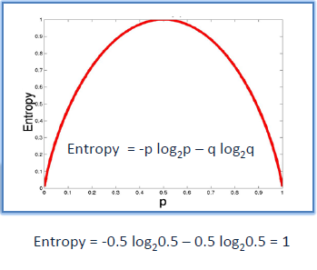
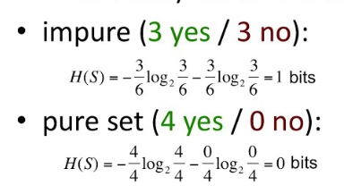
Entropy
ID3 algorithm uses entropy to calculate the homogeneity of a sample. If the sample is completely homogeneous the entropy is zero and if the sample is equally divided it has entropy of one.
H(Subset) = -p₍₊₎ *Log₂ p₍₊₎ -p₍₋₎ *Log₂ p₍₋₎

Slide 26
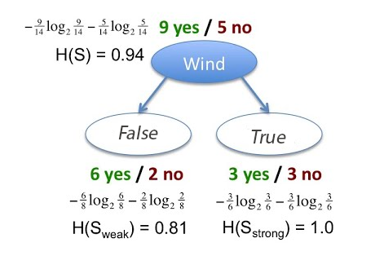
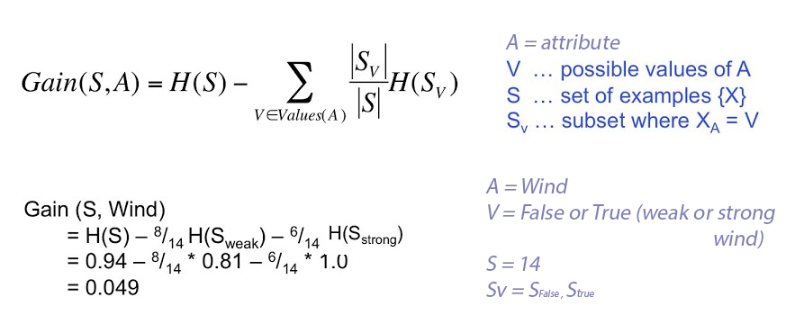
Information gain
Entropy tells us how pure or impure a subset is.
The split was good if we gained information (if the entropy drops after the split).
There is an increase of certainty of 0.049 if we picked Wind.
The Algorithm iterates to find the best attribute (feature) to split based on this IG.

